Slide 1
SecureCall CECS 579 Information Security - Project
Aniket Nade
Gagandeep Singh Randhawa

Slide 2
Content
Introduction
Adversary Scenario
SIP Stack
ZRTP
VOIP Server
Challenges
Demo
Conclusion Future Work

Slide 3
Introduction
VOIP
Voice communications and multimedia over Internet Protocol networks
ADVANTAGES
Ease of setup
Bandwidth Efficiency
Reduced monthly phone cost
Common Applications
Consumer Market
Dedicated VOIP Phones
Softphones – computers connected to network
Mobile network providers and PSTN
Wifi Calling
Smartphones with SIP clients
Corporate Use
Solutions aimed for businesses
Small to medium and Medium to Large
Notes:
https://en.wikipedia.org/w/index.php?title=Voice_over_IP&gettingStartedReturn=true#Adoption

Slide 4
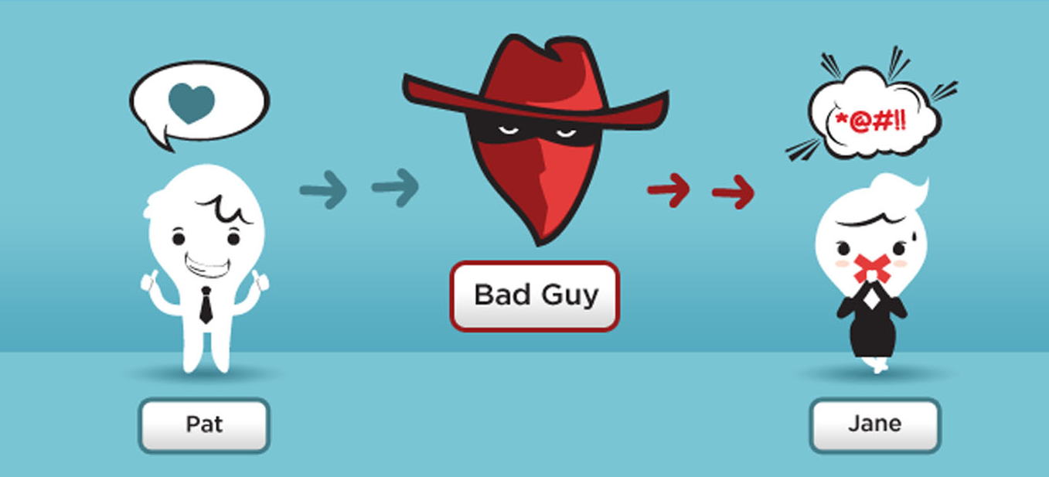

Adversary Scenario

Slide 5
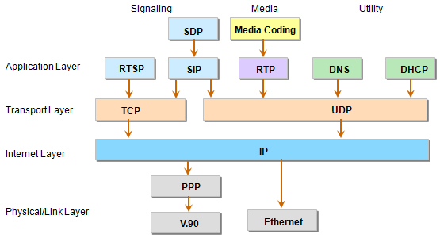
SIP A communications protocol for signaling and controlling multimedia communication sessions, viz Internet Telephony

Slide 6
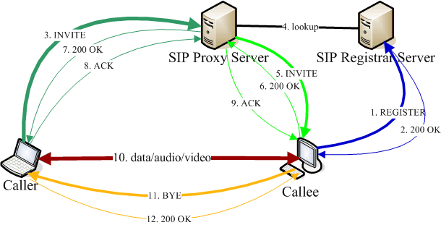
How SIP Works

Slide 7
SIP Stack – PJSIP PJSIP is free and Open Source multimedia communication library implementing standard based protocols such as SIP^{[1]}
Advantages:
Complete and Integrated
All three main components of real-time multimedia application, i.e. signaling, media features, and NAT traversal, have been taken care of by PJSIP.
Very Portable
Windows, Windows Mobile, Linux, MacOS, Android, Symbian, IOS, Blackberry OS
Compact and Small Footprint
Documentation and Resources Availability
TLS transport based on OPENSSL
Alternatives:
MJSIP
JAIN-SIP

Slide 8
ZRTP
Three phases in ZRTP
Discovery phase
Detecting if the peers supports ZRTP
Key agreement phase
Exchanging the key material
Secure phase
Confirm the cryptographic data and switch to SRTP

Slide 9
ZRTP with PJSIP
Key exchange
256 bit Diffie-Helman elliptic curve.
Authentication
HMAC-SHA1 with authentication length of 80 bit.
SAS – Short Authentication String
To detect if something went wrong during key exchange and to enable users to check integrity of the session.
ZRTP defines the length of the mandatory SAS to 16-bits, i.e. 4 characters.
A good way to check SAS is that the caller reads the first two character of the SAS, the callee reads the second 2 characters.
The use of hash commitment in the DH exchange constrains attacker to only 1 guess to generate the correct SAS in his attack.
It gives the attacker only one out of 65536 chance of being undetected.
TWOFISH
Symmetric key block cipher.
Key size 256 bits.

Slide 10
VOIP SERVER
Kind of server required for VOIP.
Non media proxy server
Server Platform Setup of ZRTP
Asterisk 1.8
Cent OS 7
libZRTP SDK

Slide 11
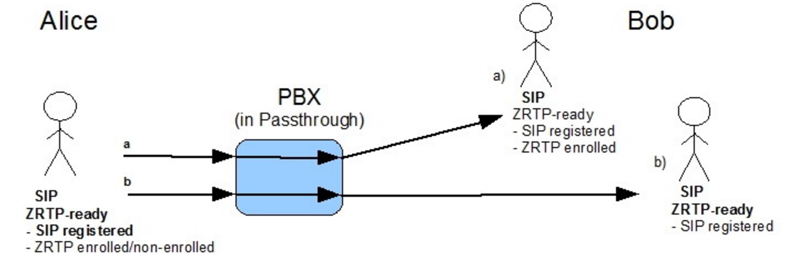
Solution
MITM SOLUTION
Source: http://zfoneproject.com/docs/asterisk/man/html/u_guide.html
SAS
SAS

Slide 12
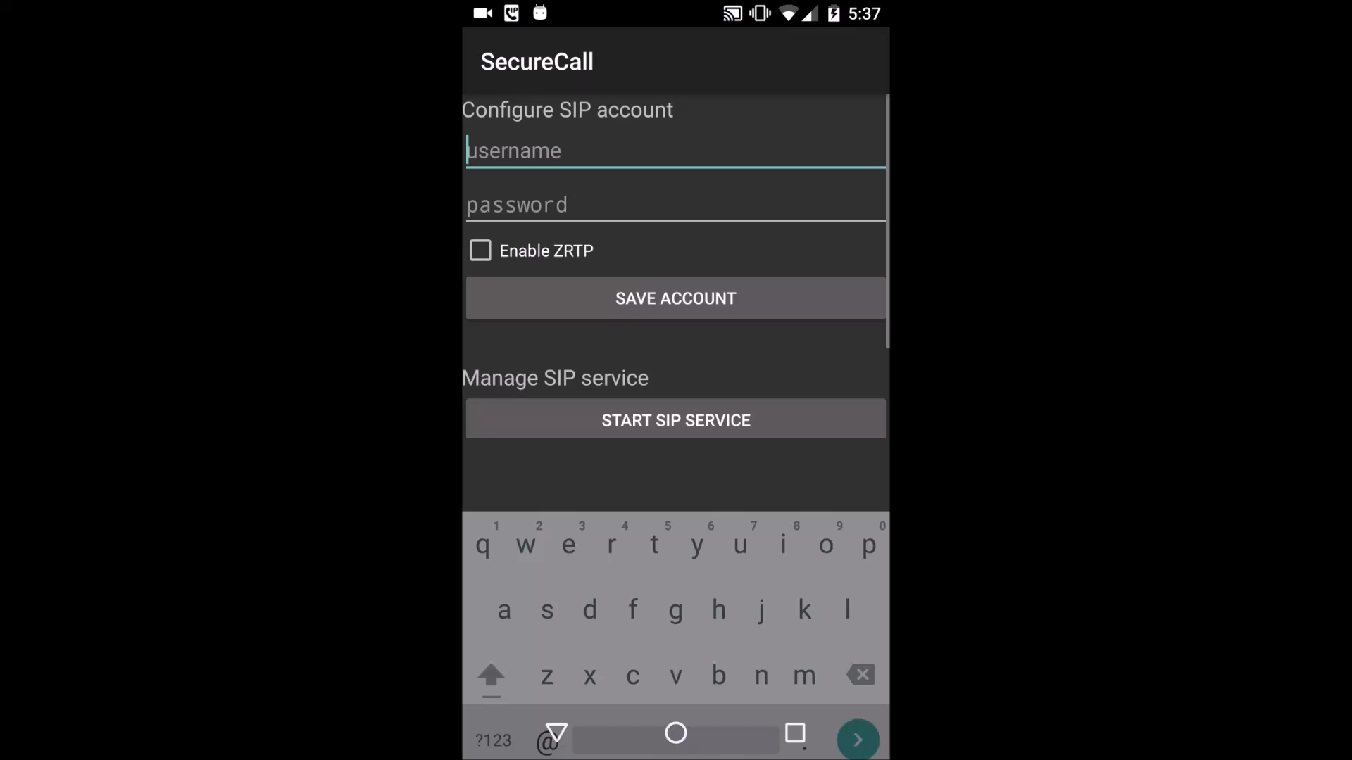
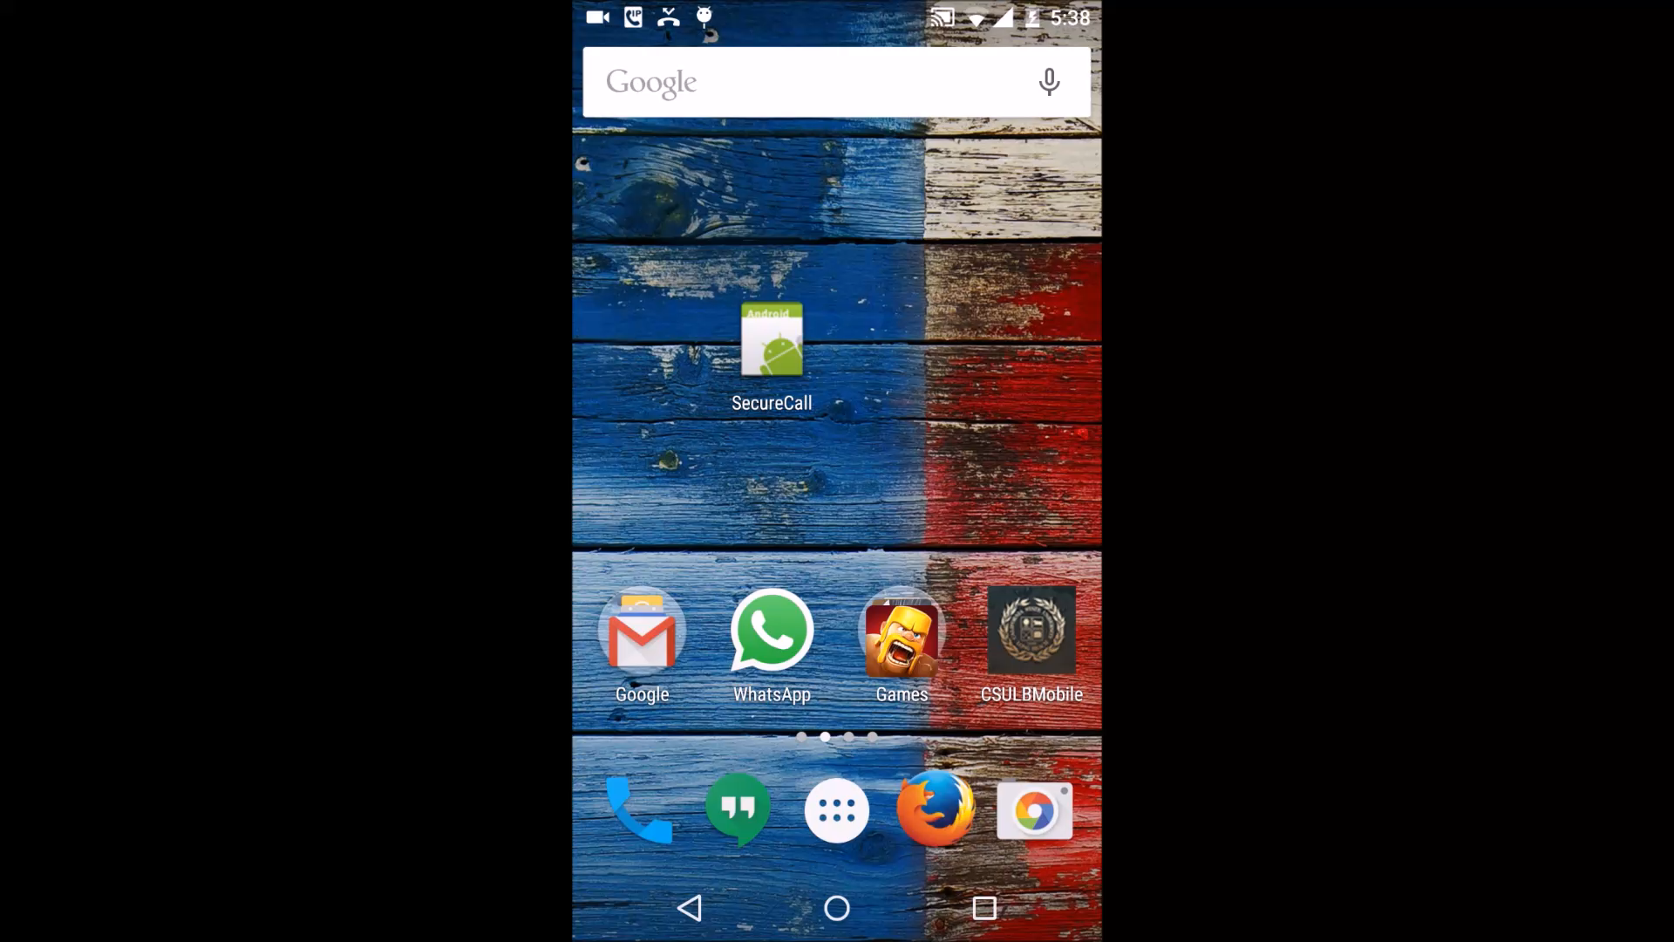
DEMO
Videos recorded using AZ Screen Recorder

Slide 13
Future Work
This system can be further enhanced for Video Calling
It might also be possible to provide support for Conference Calls

Slide 14
References
[1] PJSIP For Android: https://trac.pjsip.org/repos/wiki/GettingStarted/Android
[2] ZRTP with Asterisk http://zfoneproject.com/docs/asterisk/man/html/u_guide.html
[3] AZ Screen Recorder https://play.google.com/store/apps/details?id=com.hecorat.screenrecorder.free&hl=en

